Slide 1

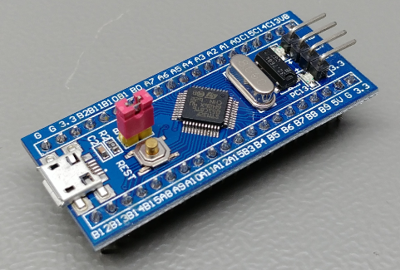
FreeRTOS LED Blinky Project on STM32f103c8t6
Discover the power of the FreeRTOS real-time operating system by creating a simple "blinky" project on the STM32f103c8t6 microcontroller. This hands-on tutorial will guide you through setting up the development environment, configuring the project, and implementing the blinking LED task.
Project By:-
2200049155 – P. Govardhan
2200049152 – V. Pavan
2200049164 - N. Vinay
2200049167 - D. Venu

Slide 2

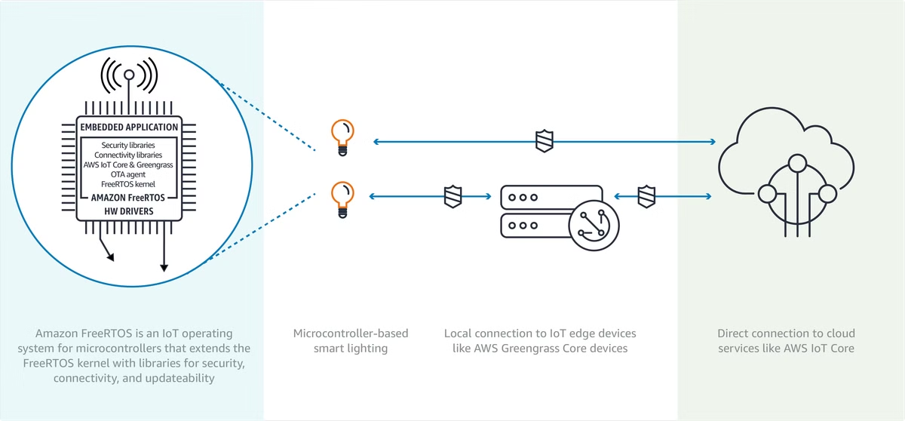
Introduction to FreeRTOS
1
Lightweight and Efficient
2
Task Management
FreeRTOS provides a robust task scheduling system, allowing you to create and manage multiple concurrent tasks.
FreeRTOS is a popular RTOS known for its small footprint and low resource requirements, making it ideal for embedded systems.
3
Interprocess Communication
FreeRTOS offers various mechanisms for task synchronization and data sharing, such as queues, semaphores, and mutexes.

Slide 3
KEY COMPONENTS
Software Tools
Hardware Setup
Configuration
Install a suitable IDE like STM32CubeIDE, along with the required toolchain (e.g., GCC for ARM) and the FreeRTOS source code.
Prepare the STM32f103c8t6 development board and necessary accessories, such as a programmer/debugger and a power supply.
Set up the project with the correct board, clock settings, and FreeRTOS configurations to ensure a smooth development process.

Slide 4

Implementing the Blinky Task
Task Creation
Task Execution
Define a FreeRTOS task that will control the blinking of an LED on the STM32f103c8t6 board.
Implement the task logic, using FreeRTOS APIs to toggle the LED and manage the blinking interval.
Task Scheduling
Integrate the blinky task into the FreeRTOS scheduler, ensuring it runs concurrently with other tasks (if any).

Slide 5

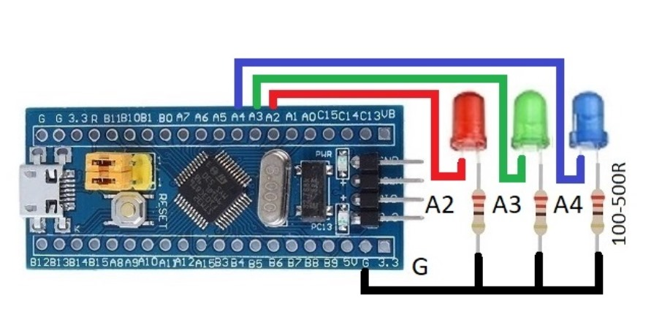
CIRCUIT DIAGRAM

Slide 6





Performance Considerations
CPU Usage
Optimize task execution to minimize CPU utilization and ensure the system remains responsive.
Memory Management
Carefully manage the use of RAM and ROM to fit within the constraints of the STM32f103c8t6 MCU.
Power Consumption
Implement power-saving techniques, such as low-power modes, to optimize the system's energy efficiency.

Slide 7


Conclusion and Next Steps
Takeaways
You have successfully created a FreeRTOS-based "blinky" project on the STM32f103c8t6 microcontroller, demonstrating the core concepts of RTOS development.
Next Steps
Explore more advanced FreeRTOS features, such as inter-task communication, real-time scheduling, and power management, to build more complex embedded applications.

Slide 8
THANK YOU…!

